Slide 1
Emotion Recognition with Machine Learning
Computer Vision-SU24
Phan Van Hai Nam— SE182309

Slide 2
Outline
Overview of Facial Emotion Recognition (FER)
Project Goals
Methodology
Experimental Results
Conclusions

Slide 3

Overview of Facial Emotion Recognition (FER)

Slide 4
What is FER?
A vital aspect of computer vision and AI
Automatically identifies human emotions from facial expressions
Enhances human-computer interaction, improves healthcare, and enables targeted marketing strategies
Why FER Matters:
Fundamental to communication: Helps us understand each other's intentions and emotional states.
Real-world applications:
Healthcare: Detecting emotional distress in patients.
Marketing: Analyzing consumer reactions to products.
Automotive: Monitoring driver alertness for safety.

Slide 5
Our Approach:
Traditional Machine Learning: Focusing on established, interpretable methods.
Feature Extraction: Utilizing Local Binary Patterns (LBP) and Histogram of Oriented Gradients (HOG) to capture unique facial characteristics.
Classification Models: Employing Multilayer Perceptron (MLP), Random Forest, and SGDClassifier for accurate emotion prediction.

Slide 6

Project Goals
Confidence-building strategies

Slide 7
Project Goals
Develop a robust FER pipeline: Accurately classify emotions from facial images using LBP, HOG, and our chosen machine learning models.
Evaluate performance: Rigorously test the model on FER2013 dataset to ensure its effectiveness across different populations and environments.
Explore potential improvements: Investigate ways to enhance accuracy and efficiency, such as feature selection and model optimization.

Slide 8
methodology

Slide 9
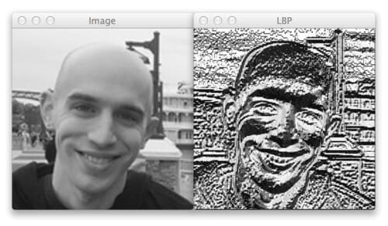
Local Binary Patterns (LBP)
What is LBP?
A texture descriptor that analyzes local pixel neighborhoods.
Compares a pixel to its neighbors, creating a binary code.
Forms a histogram to represent the image's texture distribution.
Why LBP for FER?
Computationally efficient: Real-time emotion recognition.
Robust to illumination changes: Works well in various lighting conditions.
Captures subtle variations: Detects nuances around eyes, mouth, and cheeks crucial for differentiating emotions (e.g., happiness vs. sadness).

Slide 10
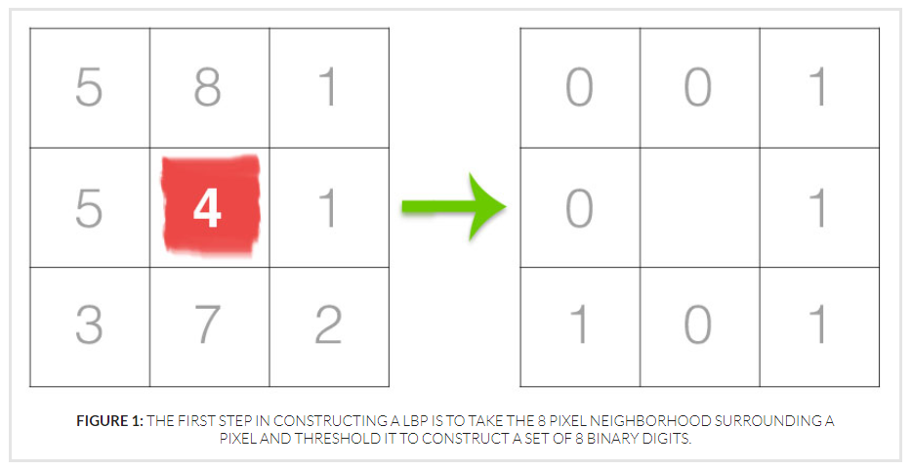
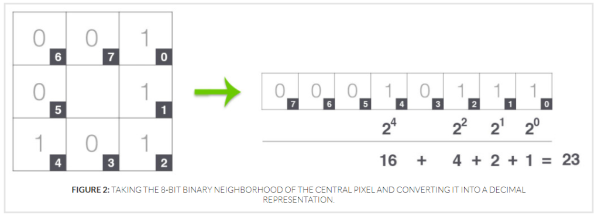
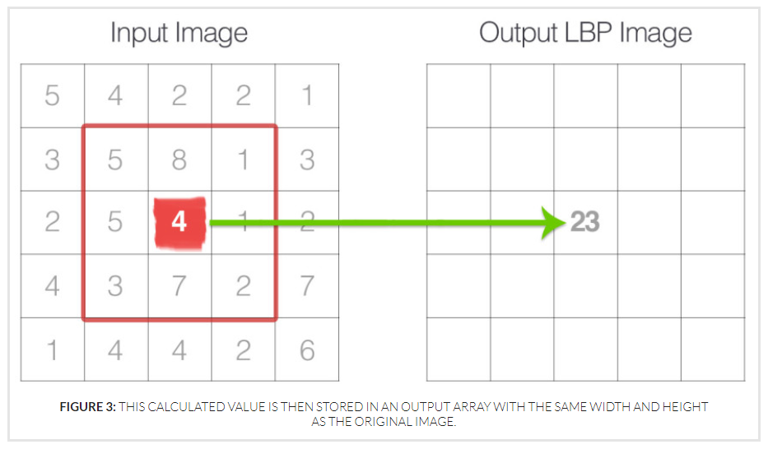
How do LBP work?
Step 1: Convert the image to grayscale
Step 2: For each pixel in the grayscale image, we select a neighborhood of size r surrounding the center pixel
Step 3: If the intensity of the center pixel is greater-than-or-equal to its neighbor, then we set the value to 1; otherwise, we set it to 0.
Step 4: The results of this binary test are stored in an n-bit binary array, which we then convert to decimal
Step 5: LBP value is then calculated for this center pixel and stored in an output 2D array with the same width and height as our input image.
Step 3
Step 4
Step 5

Slide 11
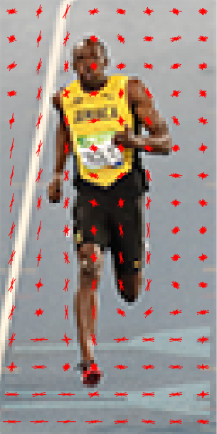
Histograms of Oriented Gradients (HOG)
What is HOG?
A feature descriptor that captures the distribution of gradient orientations (edges) in an image.
Divides the image into cells, calculates gradient histograms for each cell, and normalizes them.
Creates a feature vector representing the image's shape information.
Why HOG for FER?
Effective at describing shape: Identifies structural elements like eyebrows and mouth contours.
Robust to local variations: Handles small changes in pose and appearance.
Encodes facial features: Distinguishes expressions based on the shape of facial component.

Slide 12
LBP and HOG in FER – A Powerful Combination
Complementary Strengths:
LBP captures texture details.
HOG focuses on shape information.
Combined Use:
By combining LBP and HOG features, we can create a richer representation of facial expressions.
This can lead to improved accuracy in emotion recognition tasks.

Slide 13
Dataset

Slide 14
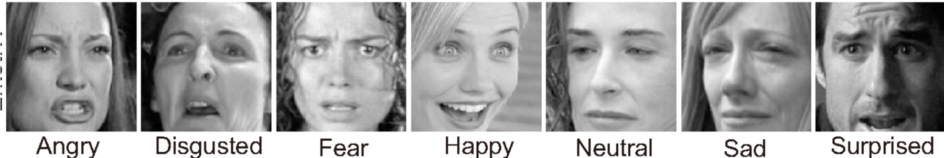
About FER-2013 Dataset
The data consists of 48x48 pixel grayscale images of faces. The faces have been automatically registered so that the face is more or less centred and occupies about the same amount of space in each image.
The task is to categorize each face based on the emotion shown in the facial expression into one of seven categories (0=Angry, 1=Disgust, 2=Fear, 3=Happy, 4=Sad, 5=Surprise, 6=Neutral). The training set consists of 28,709 examples and the public test set consists of 3,589 examples.

Slide 15
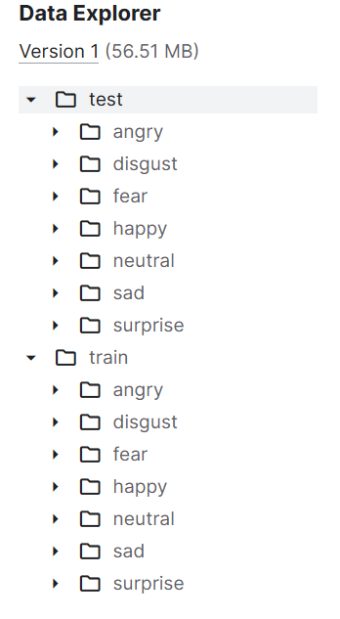
FER-2013 Data Structure
The dataset is organized into two main directories:
train: Contains 28,709 training examples, each in a subdirectory corresponding to its emotion label.
test: Contains 3,589 test examples, organized into subdirectories.
Each subdirectory (e.g., angry, happy) holds the .jpg image files for that specific emotion
CSV File Creation :
To facilitate data loading and processing, CSV files were generated for both the training and test sets.
To facilitate data loading and processing, CSV files were generated for both the training and test sets.

Slide 16
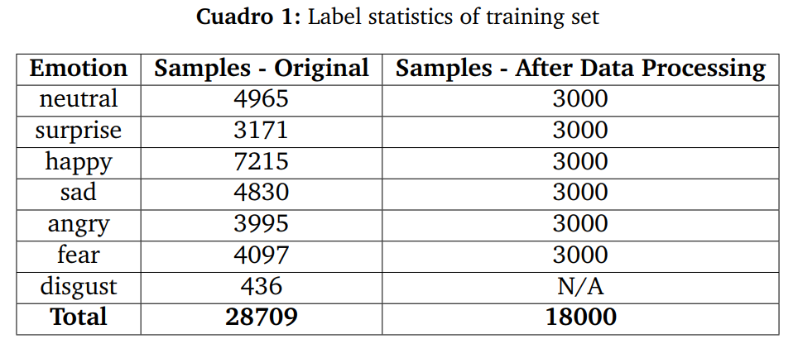
Processing imbalanced data
Notably, the ’disgust’ class is severely underrepresented with only 436 samples. => Drop this class
Undersampling of Majority Classes: for each class with more than 3000 samples. => the number of samples was reduced to approximately 3000

Slide 17
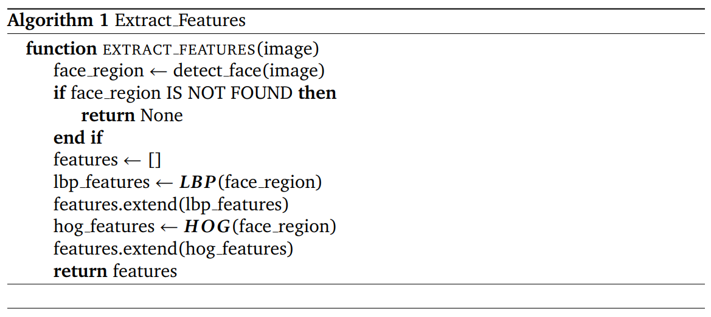
Face Feature Extraction
=> The dimensionality of the features is 130

Slide 18
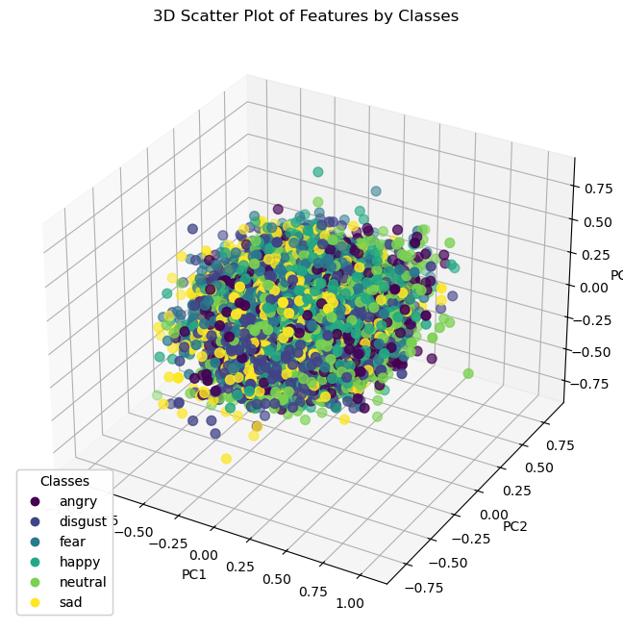
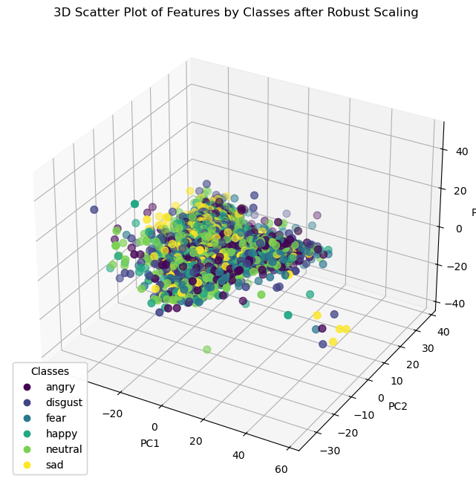
Face Feature Visualization of training set

Slide 19
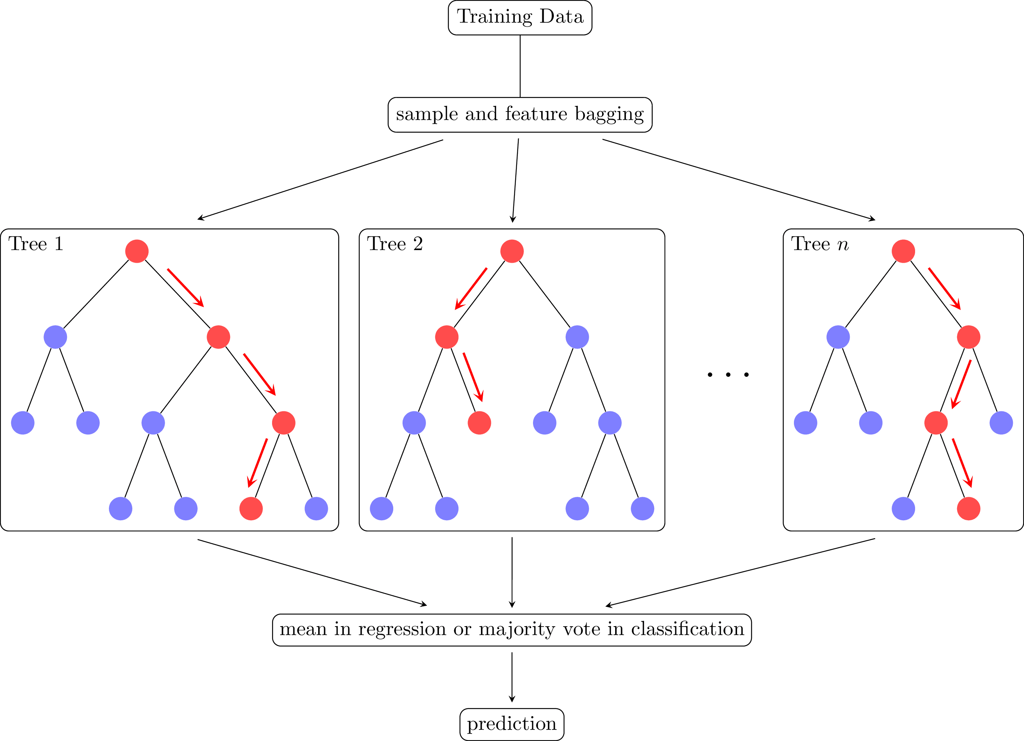
Random Forest
Random Forest is a robust machine learning algorithm that is widely used for both classification and regression tasks. It is an ensemble method, which means it combines the output of multiple decision trees to reach a single result

Slide 20
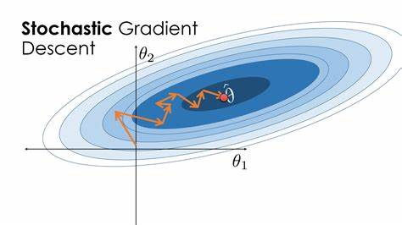
Stochastic Gradient Descent
Stochastic Gradient Descent (SGD) is an iterative method used for optimizing an objective function with suitable smoothness properties, such as differentiable or subdifferentiable

Slide 21
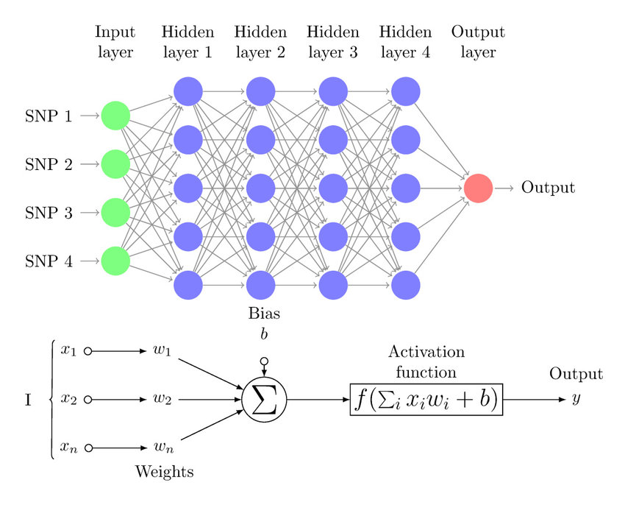
Multilayer Perceptron
Multilayer Perceptron (MLP) is a type of artificial neural network that consists of multiple layers of neurons. It’s a modern feedforward network, notable for being able to distinguish data that is not linearly separable

Slide 22
Implementation and Results

Slide 23
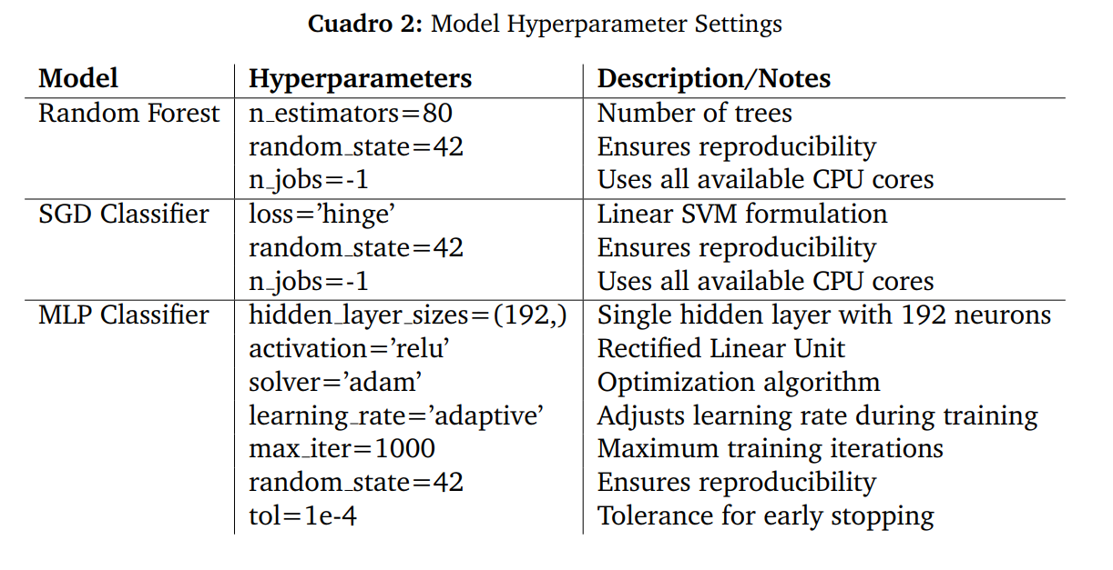
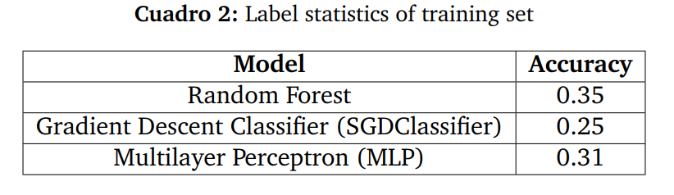
Define model and training

Slide 24
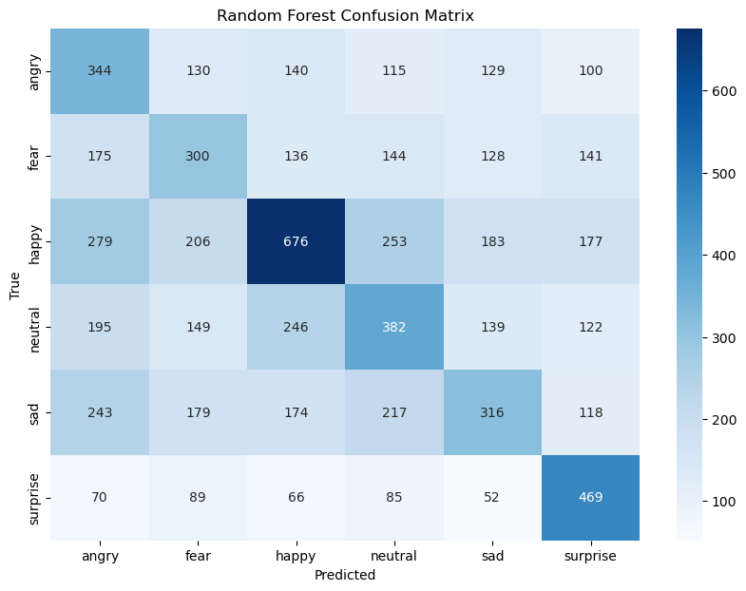
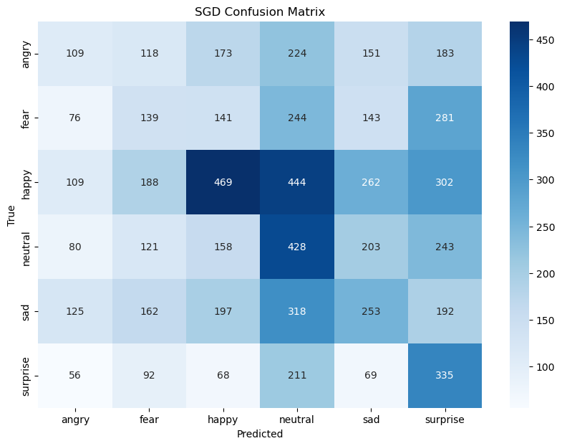
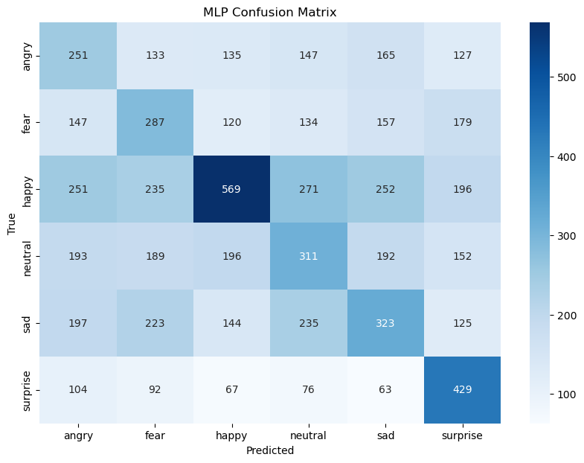
Confusion matrix

Slide 25
Conclusion
Developed a Facial Emotion Recognition (FER) system using LBP and HOG feature extraction.
Utilized MLP, Random Forest, and SGD Classifier for emotion classification.
Achieved moderate success, with room for improvement in recognizing emotions.

Slide 26
Thank you
Nam Van Hai Phan
SE182309
Computer Vision-SU24
nampvhse182309@fpt.edu.vn

